Slide 1
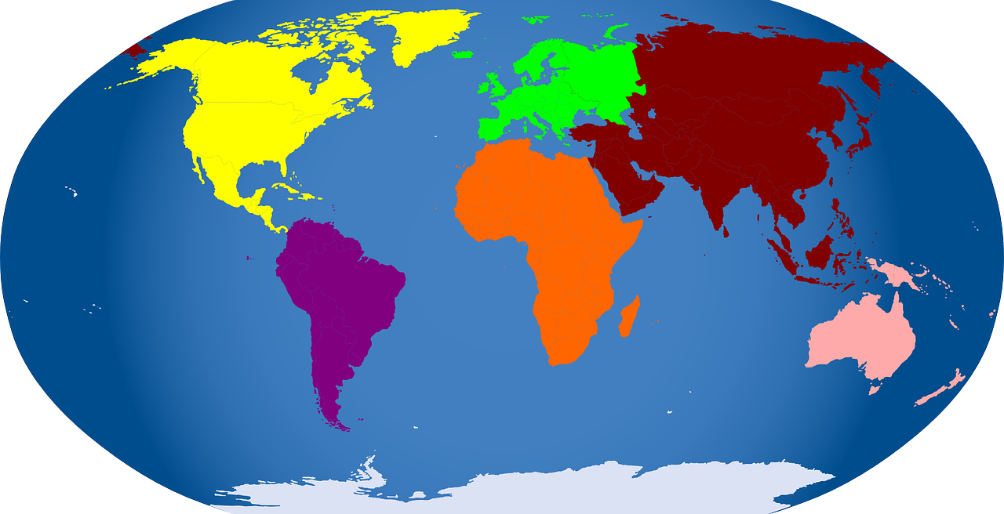
Class 3 Geography Home Learning
To identify the world’s continents and oceans.

Slide 2
Let’s remind ourselves of the world’s continents and oceans.
Arctic Ocean
Europe
North America
Asia
Atlantic Ocean
Africa
Pacific Ocean
Pacific Ocean
Indian Ocean
South America
Australia
Southern Ocean
Antarctica

Slide 3
Can you remember the names of the continents and oceans?
Arctic Ocean
A_____
Ocean
Europe
E______
Asia
North America
A____
N_____ A_______
Atlantic Ocean
A______
Ocean
Pacific Ocean
P______
Ocean
Africa
A_____
Pacific Ocean
P______
Ocean
Indian Ocean
S_____ A______
I_____
Ocean
South America
Australia
A_______
Southern Ocean
S______
Ocean
A________
Antarctica

Slide 4
Tell someone at home the names of the world’s continents and oceans.
Arctic Ocean
5
Europe
a
Asia
North America
c
d
Atlantic Ocean
1
Pacific Ocean
Africa
2
b
Pacific Ocean
2
Indian Ocean
South America
e
3
Australia
f
Southern Ocean
4
Antarctica
g

Slide 5
What about upside down?
Antarctica
b
Southern Ocean
3
Australia
a
Indian Ocean
2
Pacific Ocean
South America
1
f
Pacific Ocean
Africa
Atlantic Ocean
1
e
5
Asia
North America
c
g
Europe
d
Arctic Ocean
4

Slide 6
Activity
Notes:
LA or easy worksheet

Slide 8
Challenge
Which continent are these countries in? Look at an atlas to find out.
Country Continent
1) USA ____________________________
2) Spain ____________________________
3) Kenya ____________________________
4) China ____________________________
5) Canada ____________________________
6) Russia ____________________________
7) Sweden ____________________________
8) Peru ____________________________

Slide 9
Challenge
Which continent are these countries in? Look at an atlas to find out.
Country Continent
1) USA ____________________________
2) Spain ____________________________
3) Kenya ____________________________
4) China ____________________________
5) Canada ____________________________
6) Russia ____________________________
7) Sweden ____________________________
8) Peru ____________________________
North America
Europe
Africa
Asia
North America
Asia
Europe
South America

Slide 10
Which continent is missing?
Plenary: Can you match the continents to their names?
1
Europe
2
North America
Asia
3
4
Africa
South America
6
Australia
5
Australia
North America
Asia
South America
Africa
Europe
Notes:
This Continent matching activity is available for free at https://www.tes.com/teaching-resource/continent-matching-activity-ks1-and-ks2-12260518

