Slide 2
Aim
To understand the importance of exercise.
Success Criteria
I can talk about some of the benefits of exercise for my physical and mental wellbeing.
I understand what is meant by staying healthy and that exercise is part of this.
I know how much activity I should try to complete each day.
I can talk about some of the ways that I can be active.

Slide 3
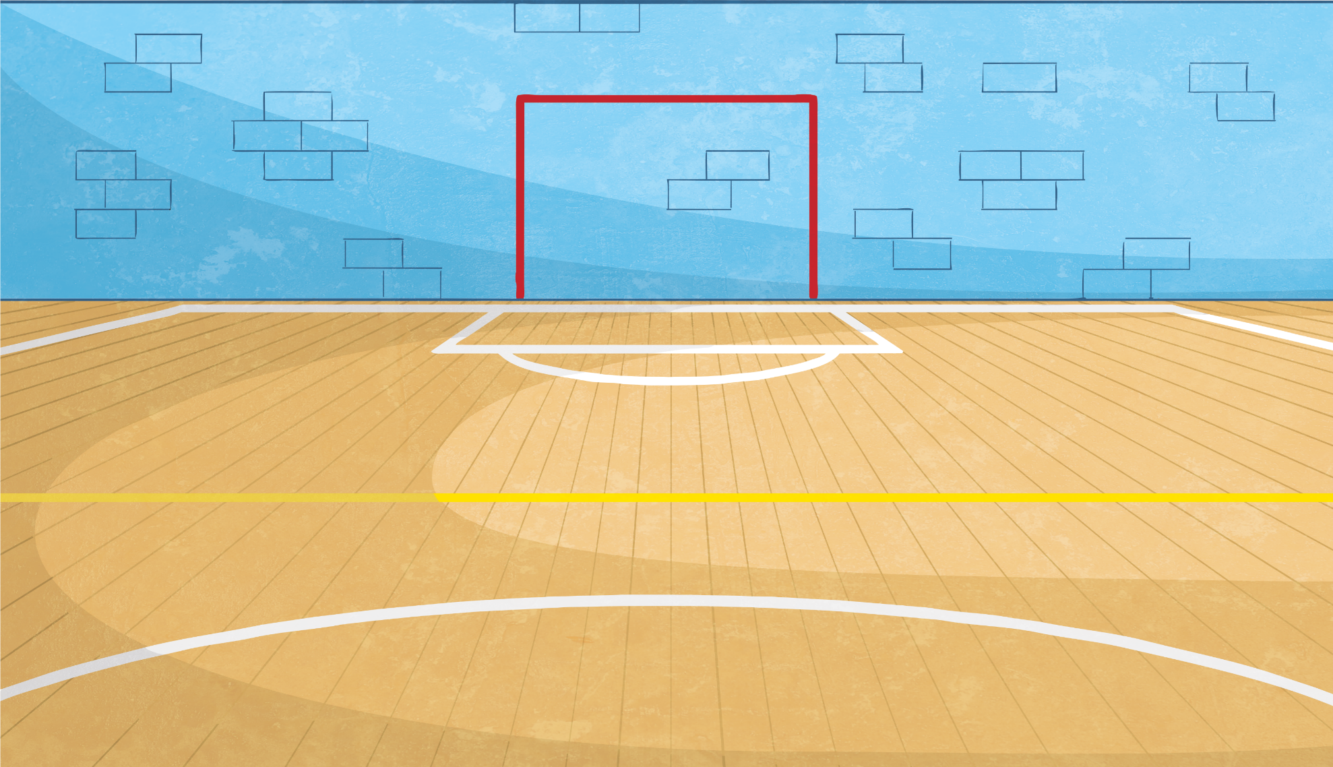
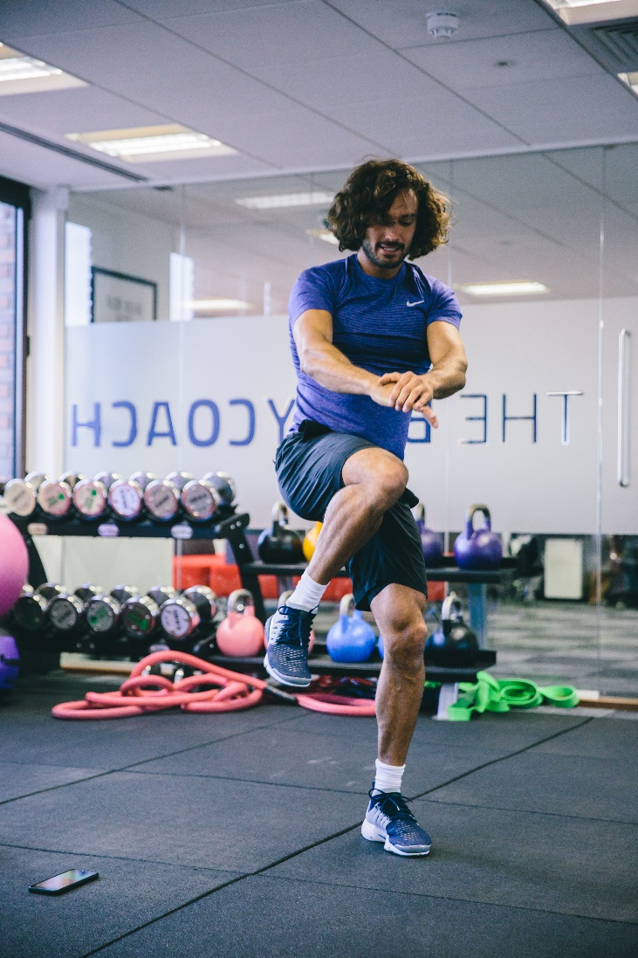
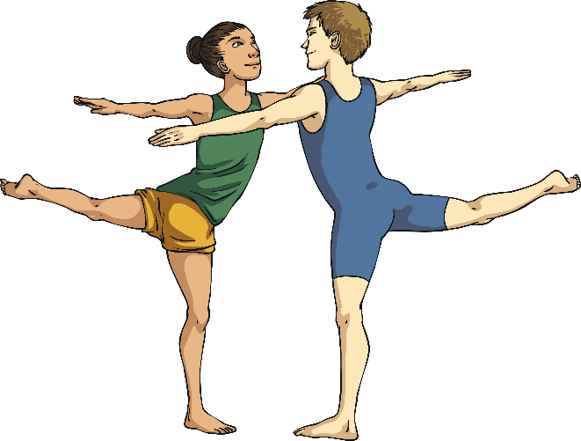
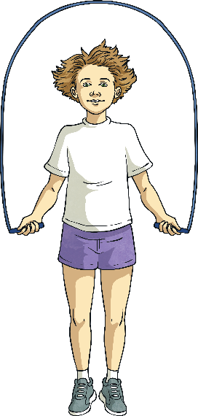
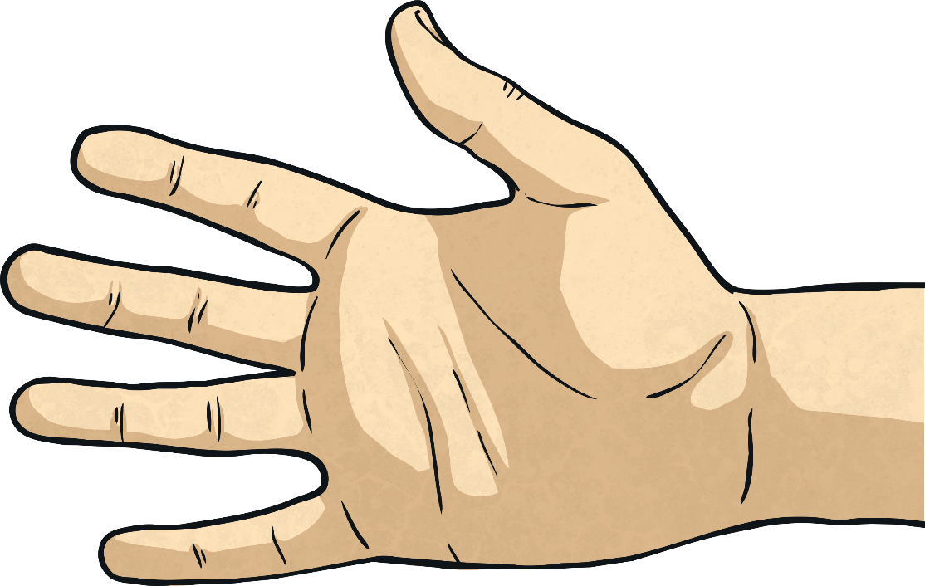
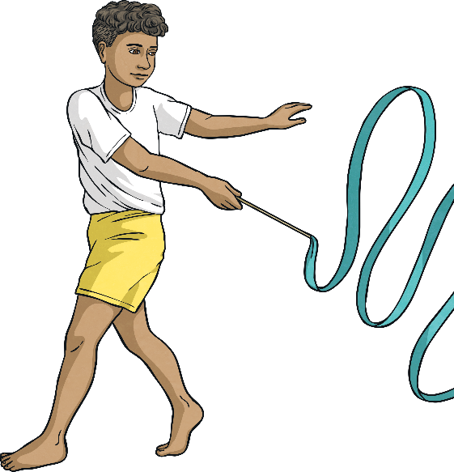
Why We Need to Exercise
What are your favourite ways of
being active?
Why do you think exercise is important?
How do you feel when you have been exercising?
How do you think exercise helps your body?
Moving and being active every day is very important.
It helps you to feel happy and confident!

Slide 4
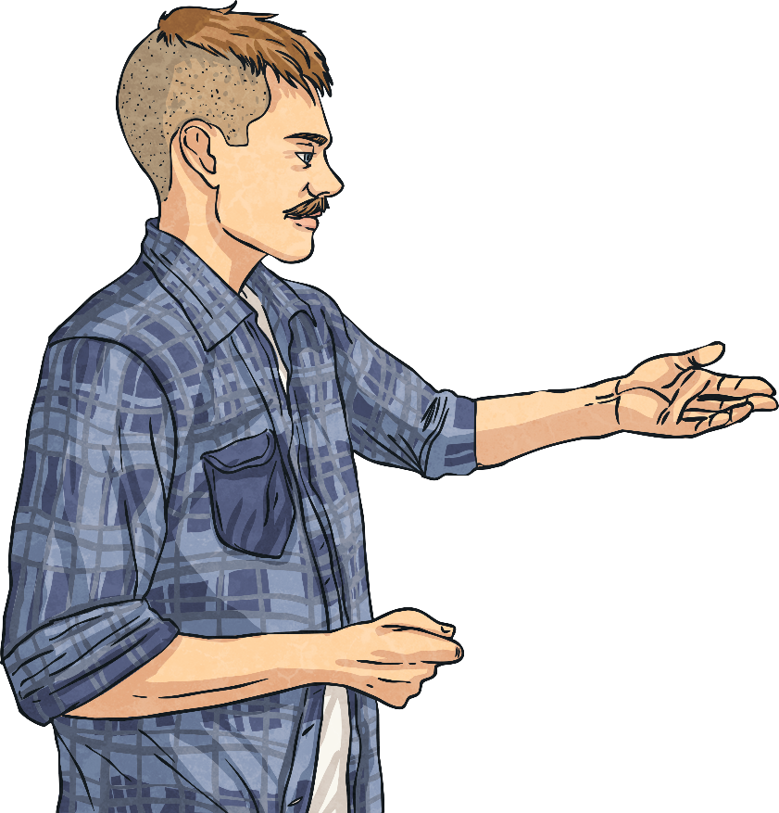
Your Body
This diagram shows the main organs of the body. Which two are most important when exercising?
?
Lungs
Were you right?
?
What do you know about these important organs?
Heart

Slide 5
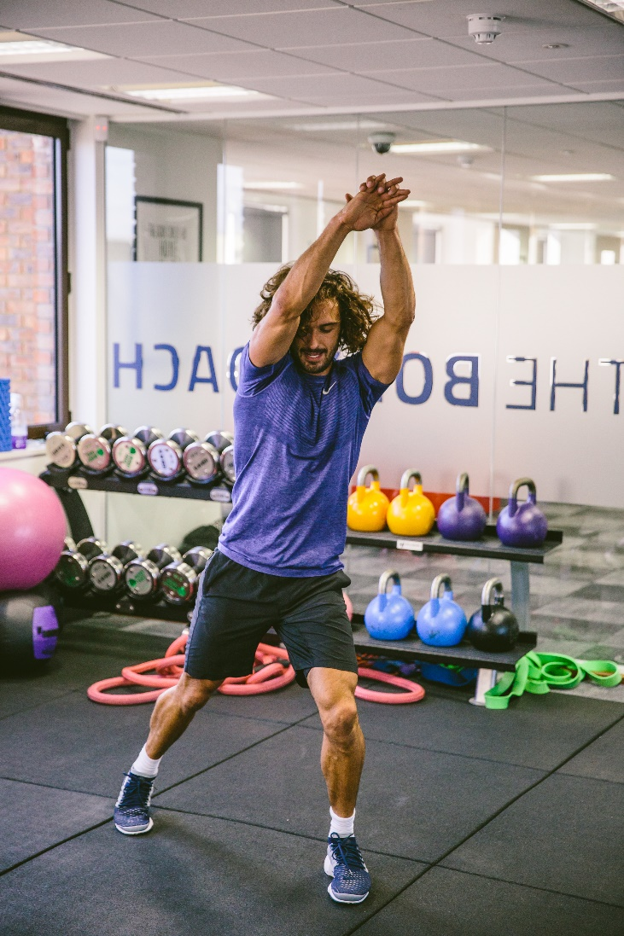
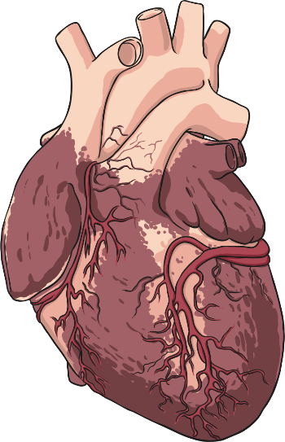
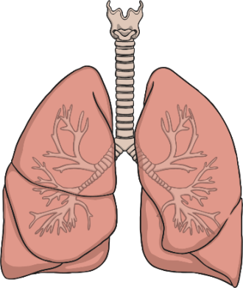
Heart and Lungs
The heart and the lungs are both
vital organs.
Can you describe the important job that they each do?
The lungs breathe in air and put the oxygen from the air into your blood. They breathe out carbon dioxide. Hardworking muscles use more oxygen. That's why breathing
gets heavier
during exercise.
The heart pumps blood around the body to carry oxygen and other important things that the body needs.
You need to get plenty of air into your lungs when you are exercising.
Exercise gets your
blood pumping.

Slide 6
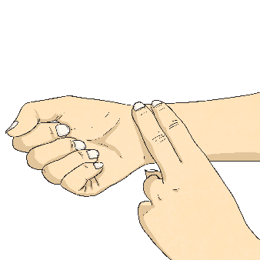
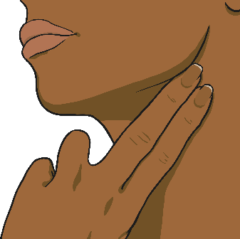
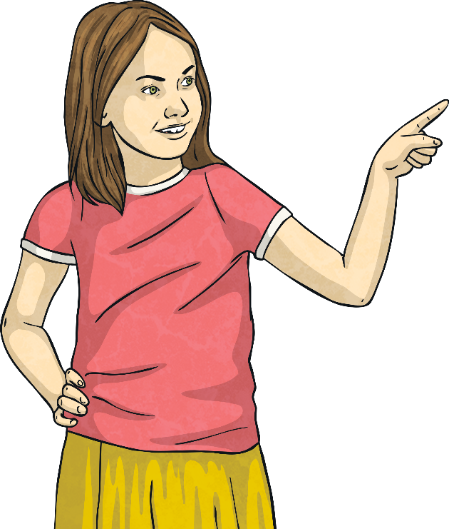
Healthy Heart
How can you measure your heartbeat?
Try taking your pulse now that you have been sitting still for some time.
You can measure your heartbeat by taking your pulse.

Slide 7
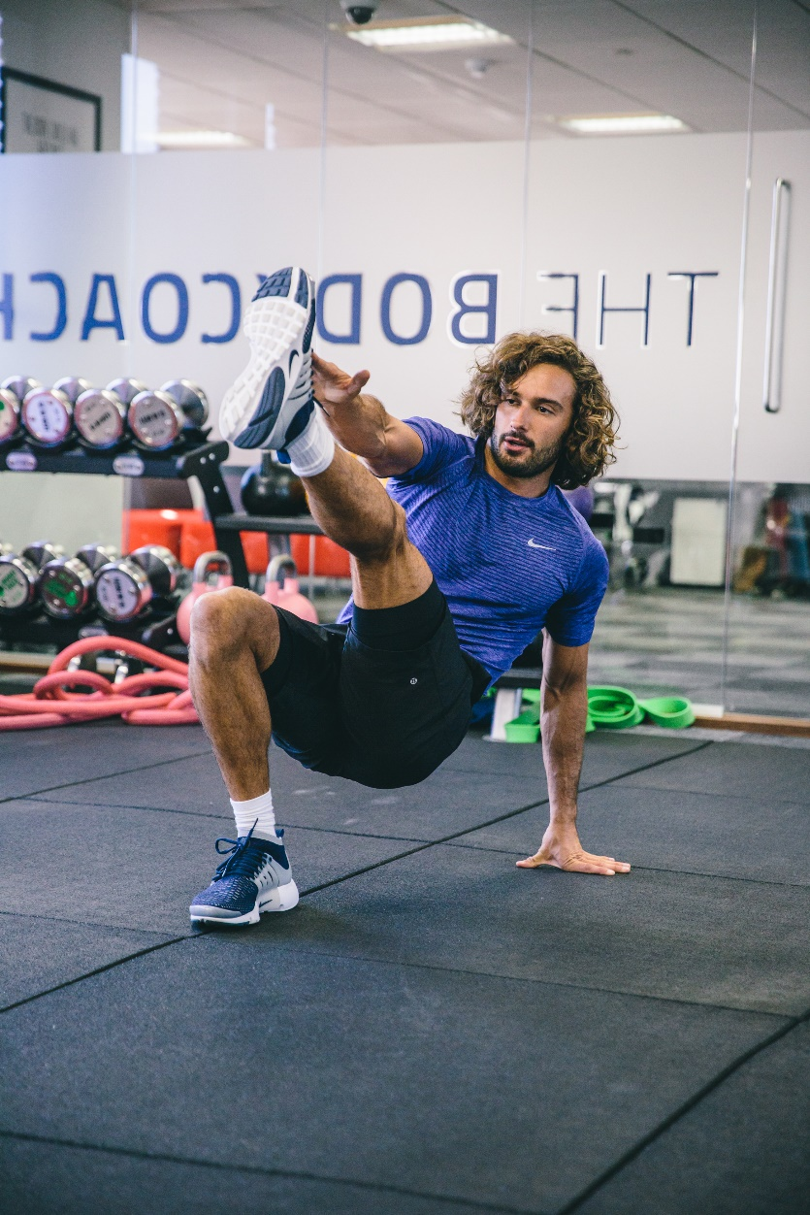
Why We Need to Exercise
End
1
2
3
4
5
6
7
8
9
10
11
12
13
14
15
16
17
18
19
20
21
22
23
24
25
26
27
28
29
30
31
32
33
34
35
36
37
38
39
Start
We are now going to stand up and do quick marching on the spot for 40 seconds.
Well Done!
How high can you lift your knees up?
Keep your
back straight.
Push your knees as high as you can.
March on the spot.
Pump your arms.
Lift your knees up.
Make sure you have plenty of room.
Take your pulse again. How has your heart rate changed?
Talk to a partner about how your body now feels.

Slide 8
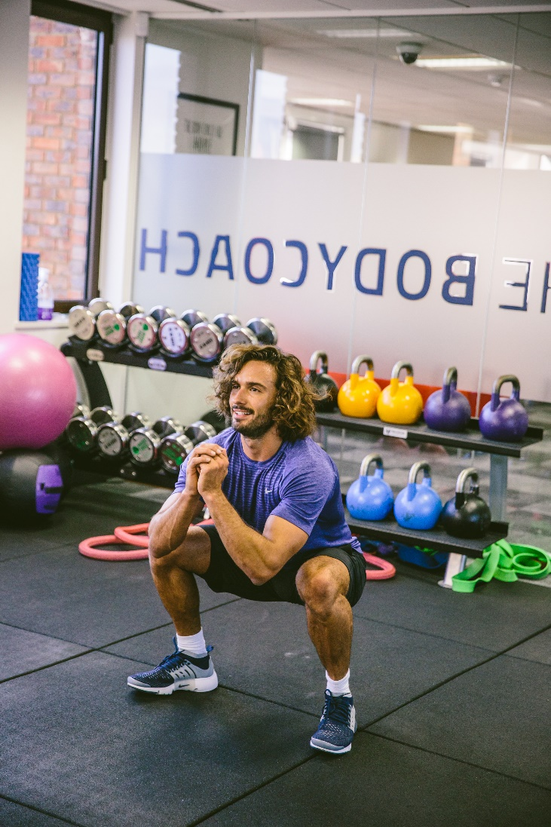
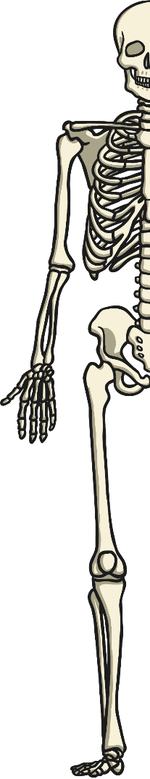
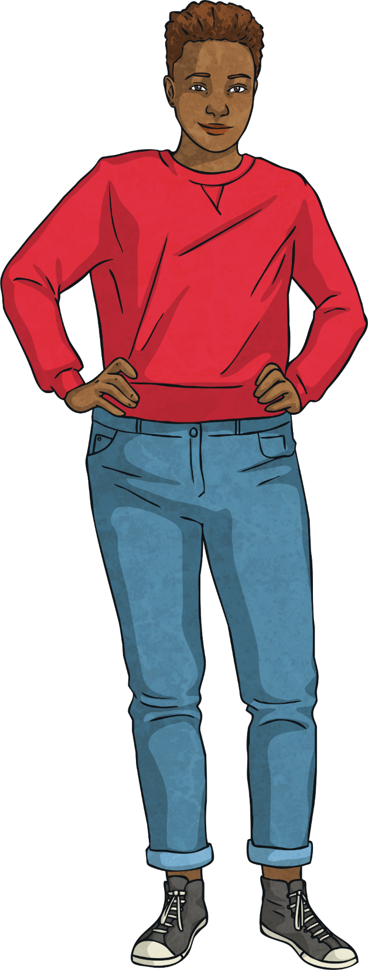
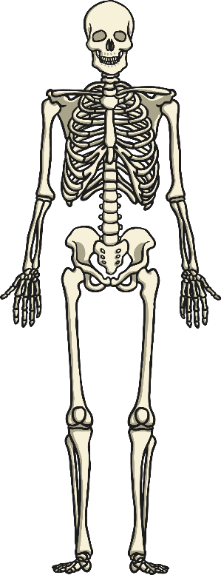
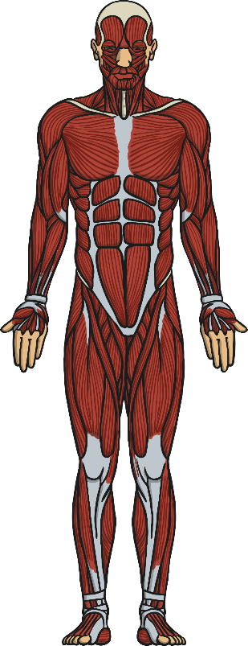
Bones and Muscles
Do you know the names of any of your bones or muscles?
Abdominals
Quadriceps
Femur (thigh)
Tricep
Tibia
Pectoral
Bicep
Fibula
Oblique
Gluteus Maximus
Radius
Hamstrings
Ulna
Vertebral Column
Pelvis
Thoracic Cage (ribs)
Humerus
Your bones and muscles work together to give you strength and power for your favourite activities.
Stand up to find some examples of bones and muscles.
You wouldn’t be able to move without the bones and muscles in your body.
Read the names and find each on your own body.

Slide 9
Brain Boost
When the heart beats faster, it pumps more oxygen to the brain.
Movement helps people to concentrate better.
Exercise can also help to improve learning.
Being active is also great
for your brain.
Source: UK Chief Medical Officers’ Physical Activity Guidlines

Slide 10
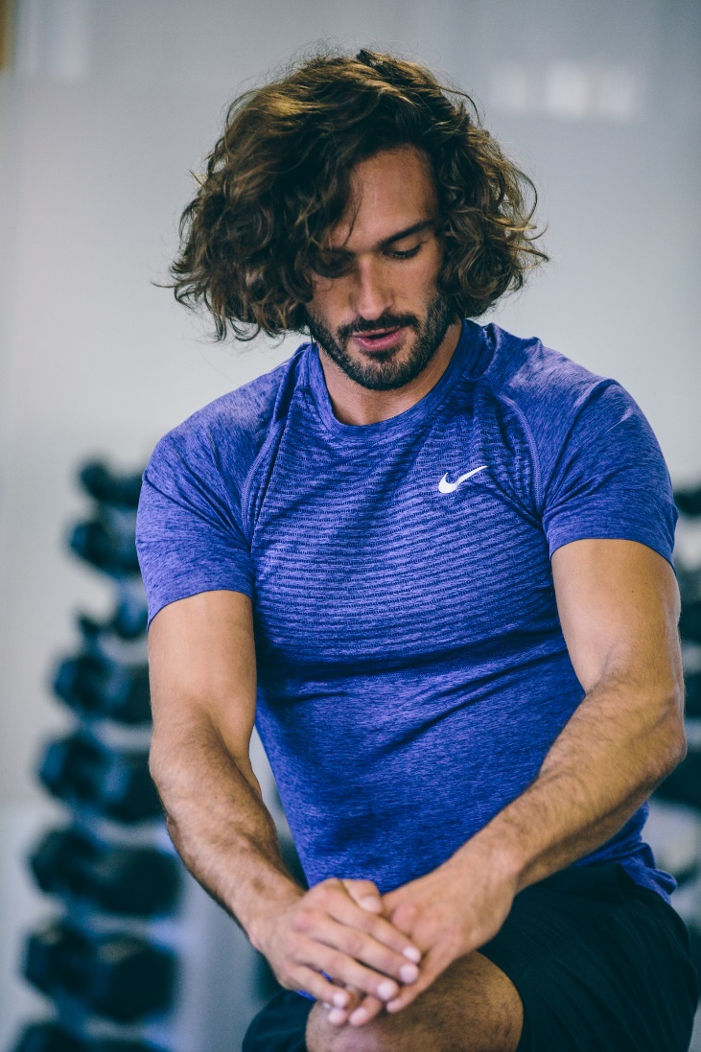
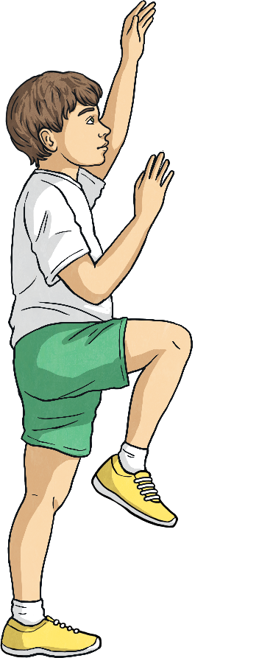
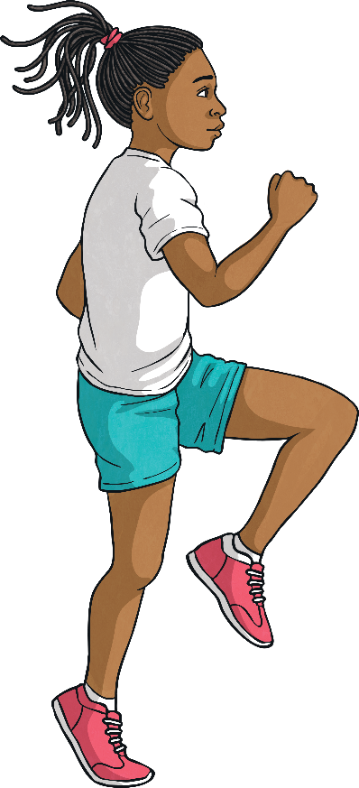
Feeling Fabulous!
Being active helps people to have
more energy to enjoy doing the things they love.
Movement is great for our physical wellbeing. Exercise also helps our mental wellbeing, which is just
as important.
Many people feel more relaxed and positive
after exercising.
It can help people to sleep better.

Slide 11
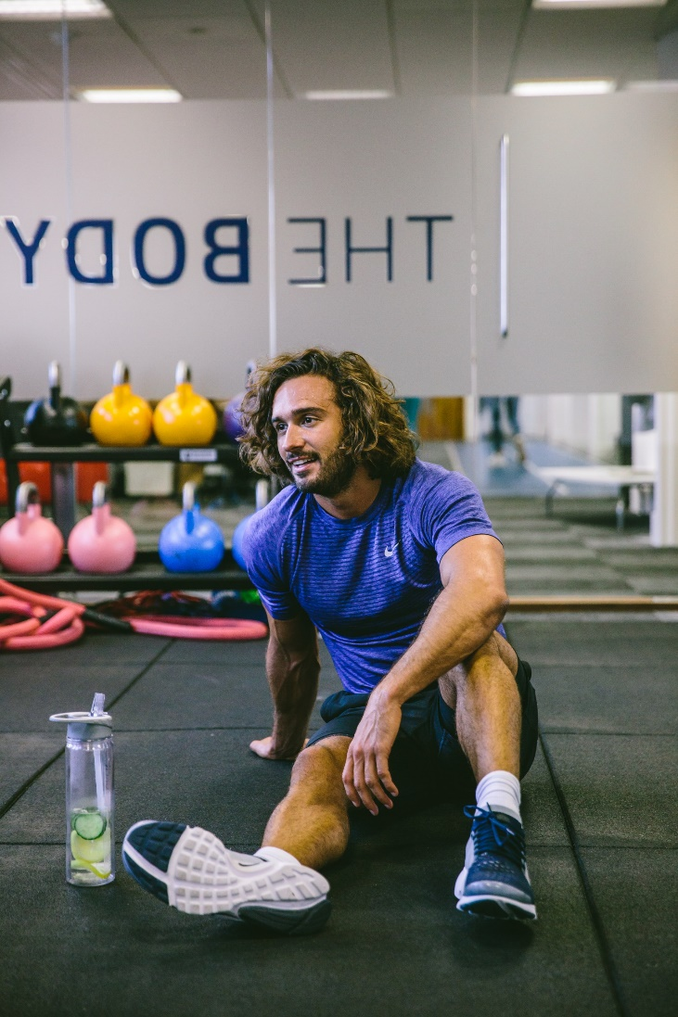
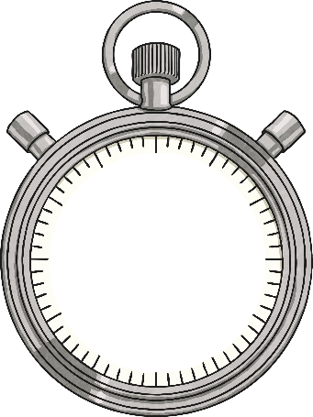
How Much Should You Exercise?
15 minutes
30 minutes
You should try to be active for at least 60 minutes (or one hour) each day.
Being active everyday is really important.
How long do you think you should spend exercising each day?
Remember: this doesn’t have to be all in one go.
45 minutes
60 minutes
Were you active for at least 60 minutes yesterday?

Slide 12
Being Active
Think about a typical week. What different physical activities do you do?
Make a grid on your whiteboard to help you add up your active minutes.
Share your ideas with a partner.
 | Before School | At School | After School
Monday | Walk to school 20 mins | PE 50 mins Playtime 2 × 15 mins | Walk home 20 mins Dance class 45 mins
Tuesday
Wednesday
Thursday
Friday
 | Morning | Afternoon | Evening
Saturday
Sunday
Do you and your partner have similar ways of being active?

Slide 13
Being Active
Here are some of the ways that you might get moving.
What other ways do you get active?
There are activities to suit everyone!

Slide 14
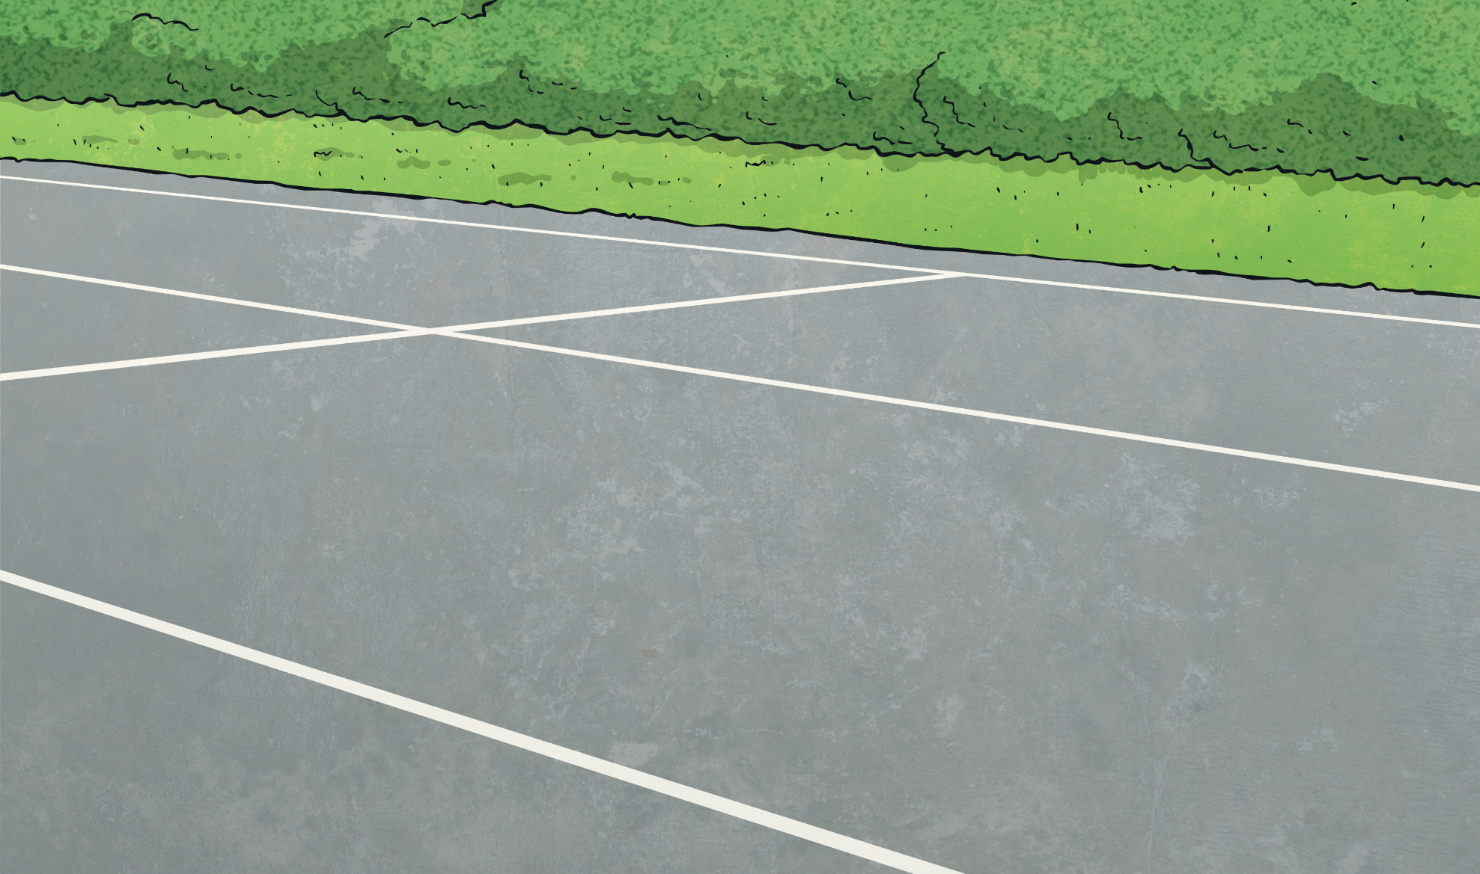
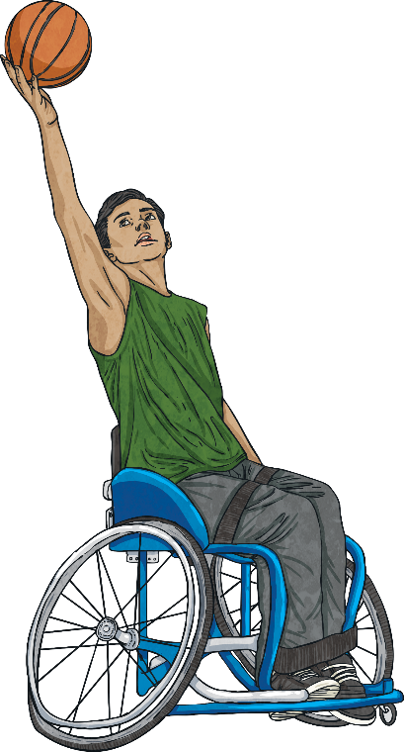
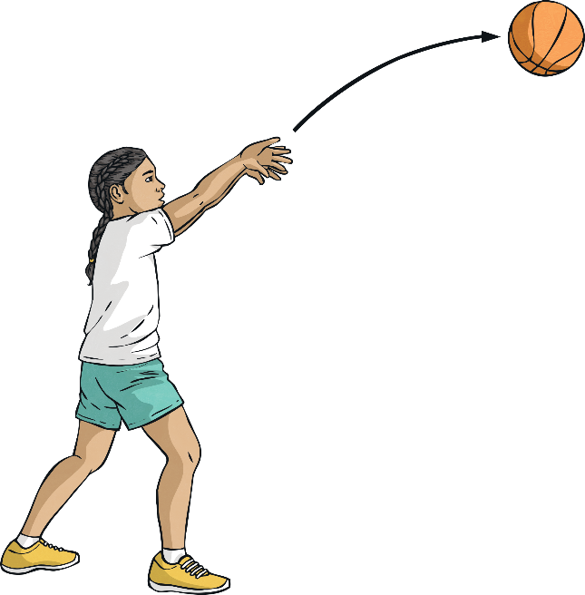
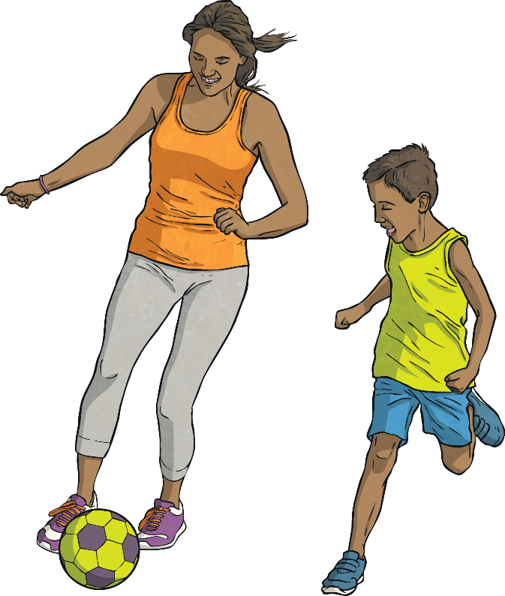
Have Fun!
It doesn’t matter how you choose to move.
Choose ways that you enjoy.
Being active with your friends and family can make it even more fun.
What activities do you enjoy with your friends and family?
Do you think you do a sport or exercise that none of your friends have tried? Which exercises have you never tried that you would like to have a go at?

Slide 15
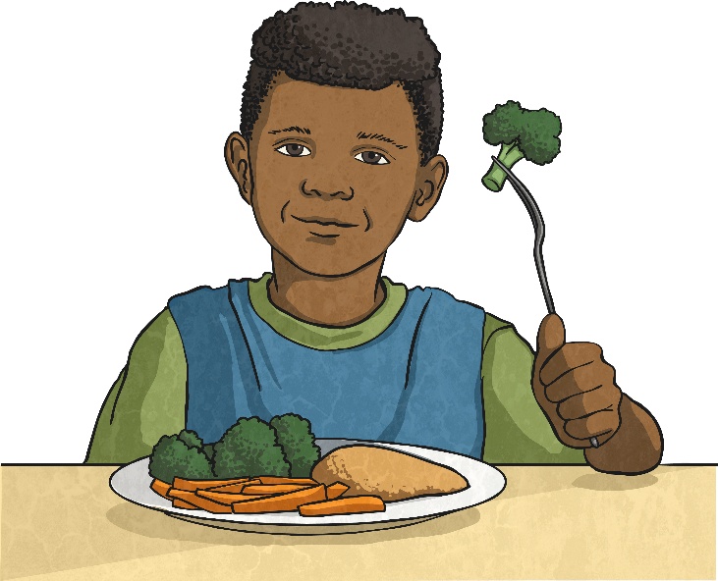
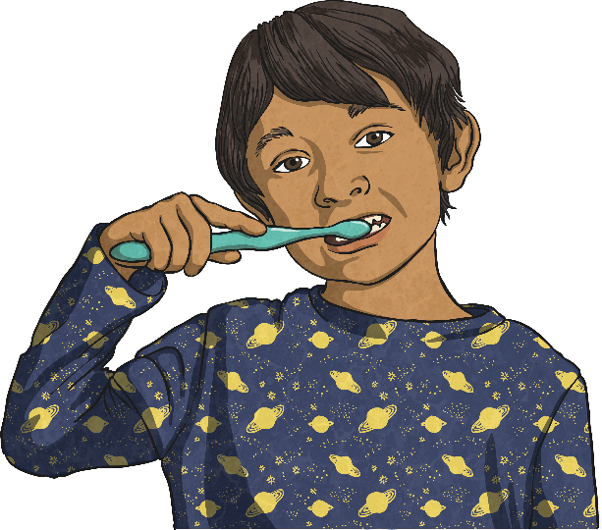
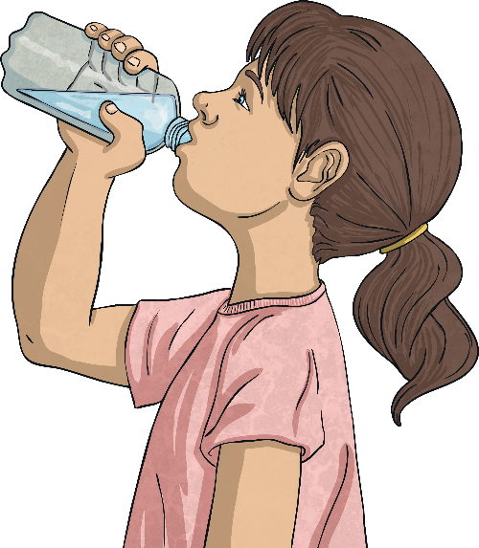
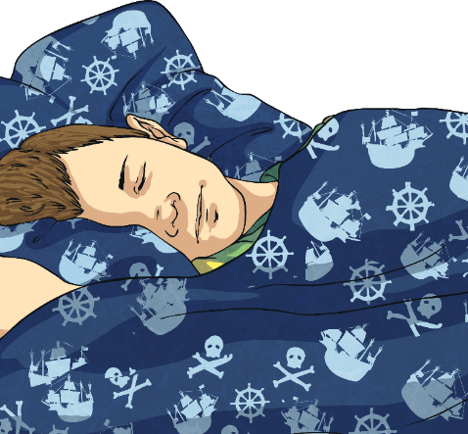
Staying Healthy
Moving and being active is an important part of staying healthy.
As well as exercise, what else can you do to help your body and mind to stay healthy?
What does staying healthy mean?
Staying healthy means looking after your body so that it can do all of its important jobs.
How many of these things did you think of? Did you think of any more?
Eat a
balanced diet.
Keep your body and teeth clean.
Drink plenty
of water.
Get plenty
of sleep.

Slide 16
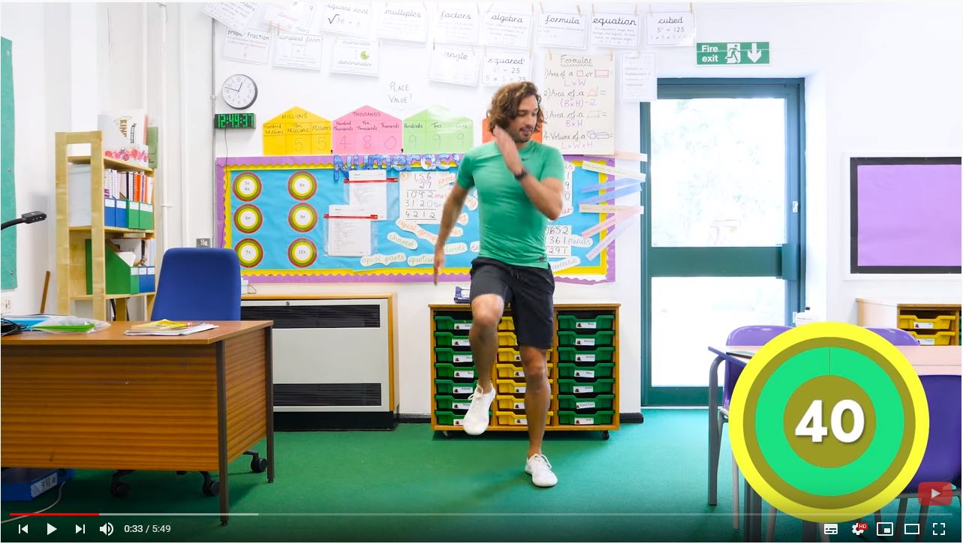
Joe Says…
Try to be active for 60 minutes each day to stay healthy and happy!
Try this Active 8-Minute Workout to add to today’s total.

Slide 17
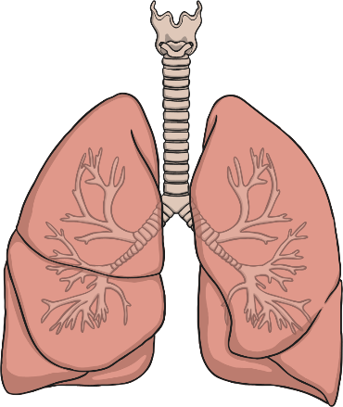
Help Your Body
Can you remember how exercise helps these parts of your body? Tell your partner.
What happens to your heart rate
when you are being active?
Your heart rate gets faster so that it can
pump more oxygen to your muscles as
they are using it up.
Exercising builds up your lungs’ ability to use oxygen well.
Being active makes your bones and muscles stronger.
It strengthens your heart so that it works well to pump your blood.

Slide 18
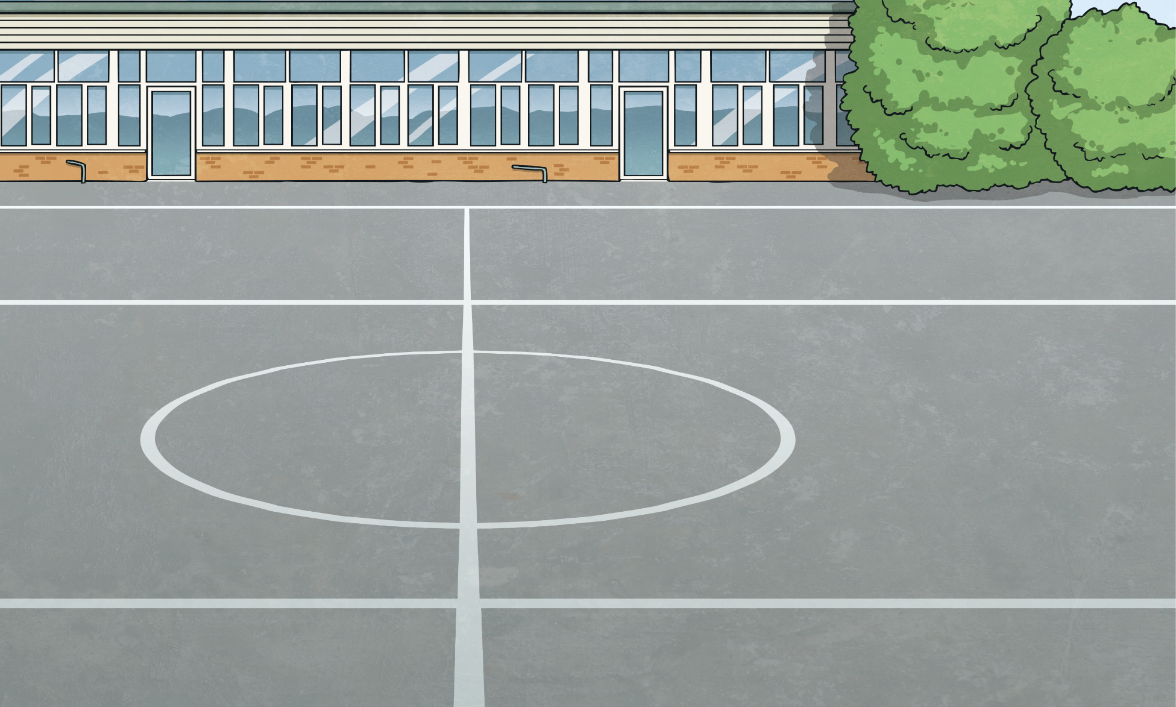
Why Do We Exercise?
Did you remember any of these reasons to be active?
Why do we exercise?
Being active is good for our brain and helps us to concentrate so that we
can learn better.
Exercise is good for our mental wellbeing and can help us to feel more confident.
It’s fun!
It’s part of keeping our body healthy.
It’s good for our heart, lungs, bones and muscles.

Slide 19
Aim
To understand the importance of exercise.
Success Criteria
I can talk about some of the benefits of exercise for my physical and mental wellbeing.
I understand what is meant by staying healthy and that exercise is part of this.
I know how much activity I should try to complete each day.
I can talk about some of the ways that I can be active.

