Slide 1
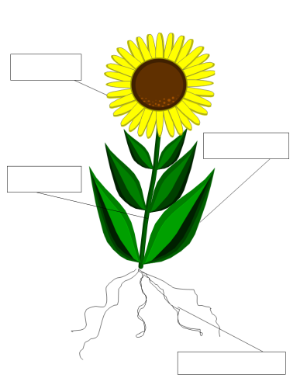
11.1.21 Class 3’s Science Lesson Parts of a Plant

Slide 2
Can you name the parts of a plant?
flower
leaf
stem
roots

Slide 3
Each part of a plant has a special job.
flower
leaf
stem
roots

Slide 4
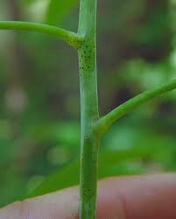
Stem
The job of the stem is to support the plant and keep it upright.

Slide 5
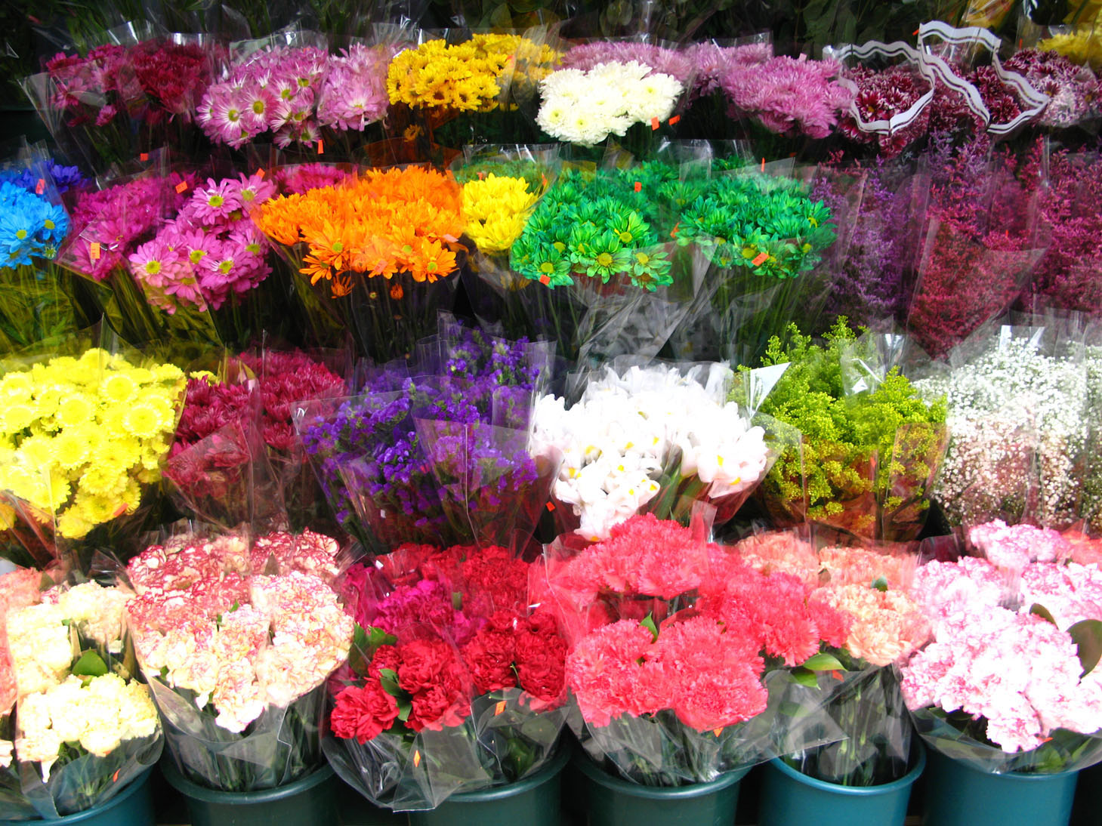
Flower
The job of the flower is to attract insects.

Slide 6
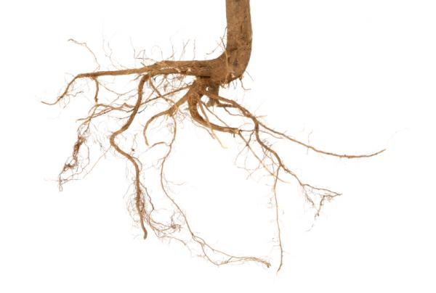
Root
The job of the root is to take up water and nutrients from the soil.

Slide 7
Leaf
The job of the leaf is to soak up the sunlight for the plant.

Slide 8
Can you name the parts of a plant and identify their function?
flower
leaf
stem
roots

