Slide 1
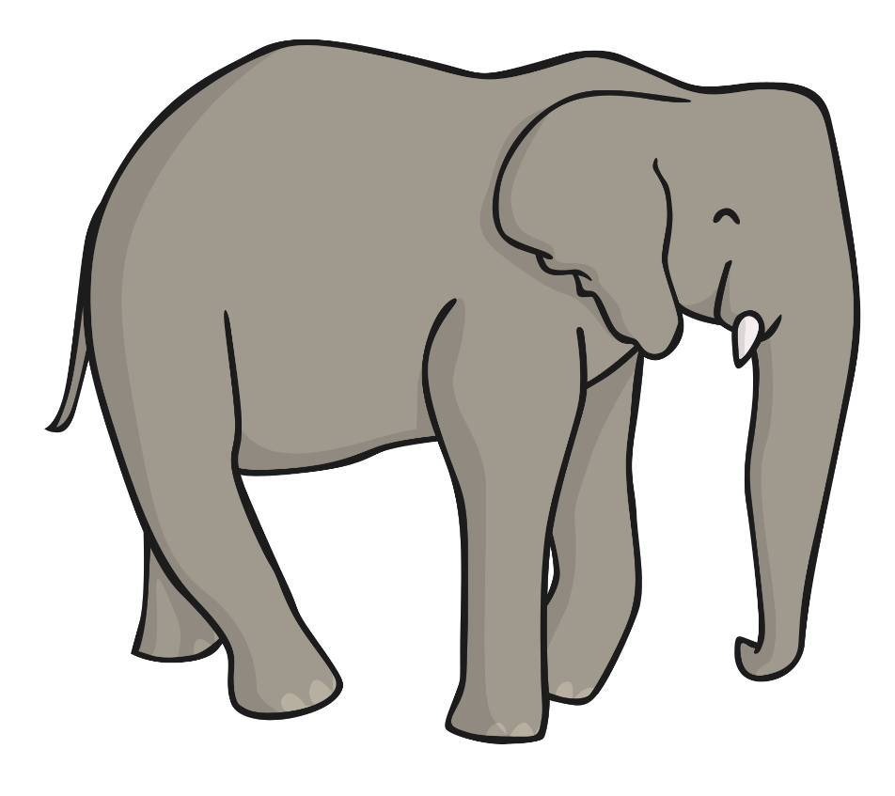
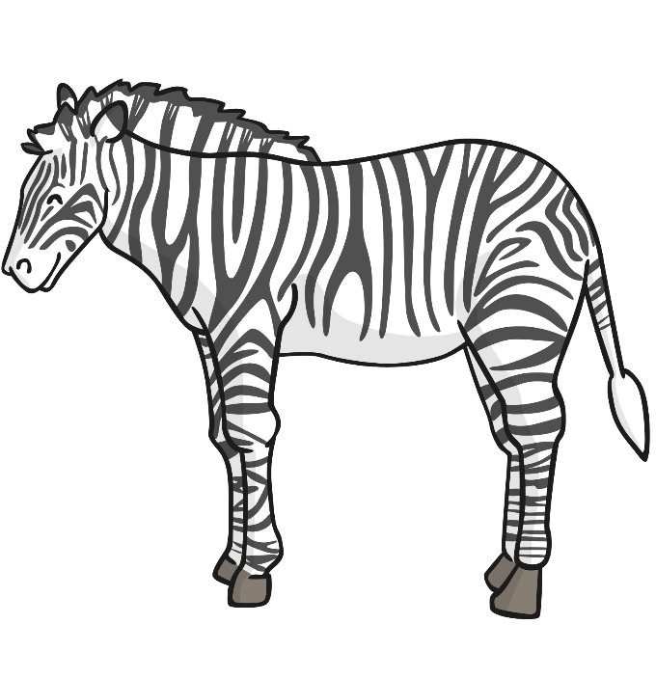
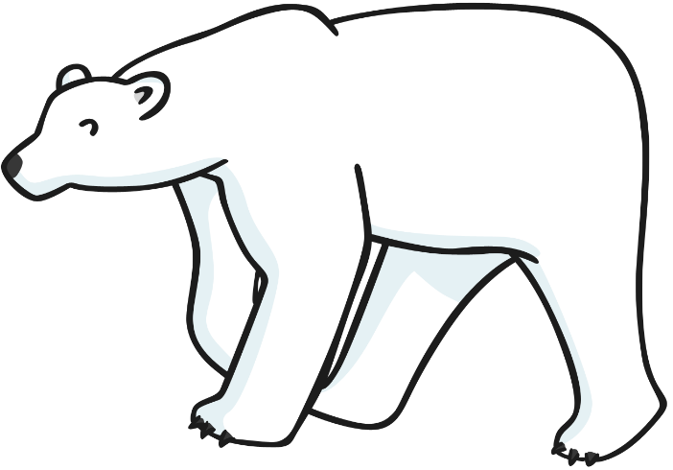
Adaptation

Slide 2
Polar Bear
Polar bears live in the Arctic.
Polar bears large feet stop them sinking into the snow.
Polar bears have white fur so that they blend into their habitat.
Their fur is very thick to keep them warm.
Polar bears have sharp claws for catching their prey and gripping to the ice.

Slide 3
Frog
Frogs live in ponds or damp environments.
Frogs have long tongues to catch flies.
Frogs have big, strong hind legs for leaping long distances.
Frogs are usually coloured the same colours as their habitat, so they are camouflaged. This makes it harder for predators to see them.

Slide 4
Dolphin
Dolphins live in the sea.
Dolphins are very stream line helping them to move quickly and smoothly through the water.
Dolphins use their fins to swim.
Dolphins have an air hole on the top of their head allowing them to breathe.

Slide 5
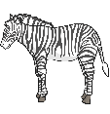
Zebra
Zebras live in grassland.
Zebras have strong legs for running fast away from predators.
Zebras are tall to help them look out for predators.
Zebras use their stripes for camouflage. This helps them to blend into the background and make it harder for predators to spot them.

Slide 6
Elephant
Elephants live in dry grassland.
Elephants use their tusks for protection, attracting and fighting for females and knocking over trees.
Elephants have little hair so they do not over heat.
Elephants have large feet to support their body.
Elephants trunks can sense the size, shape and temperature of an object. They use their trunks to pick up food and drink water.
Elephants have large thin ears. Their ears are made from a complex network of blood vessels which regulate an elephants temperature.

Slide 7
Changes to Habitats
Most habitats do not stay the same all the time.
Habitats change daily and seasonally.
Daily changes to habitats:
The amount of light changes between day and night.
The temperature is hotter during the day than at night.
The amount of water changes for example rainfall and tidal variation.

Slide 8
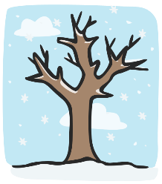
Changes to Habitats
Most habitats do not stay the same all the time.
Habitats change daily and seasonally.
Seasonal changes to habitats:
The amount of light changes during the day. Summer days have much more day light than winter days.
The temperature is hotter during the summer months than winter months.
Changes to the amount and variation of vegetation, there is a lot in the summer and trees are usually bare in the winter and the ground covered in snow.

Slide 9
Questions
How are plants and animals adapted for daily change?
Most flowers open their petals during the day for pollination and close them at night for protection.
Some animals avoid predators by being nocturnal. However some animals specialise at hunting at night!

Slide 10
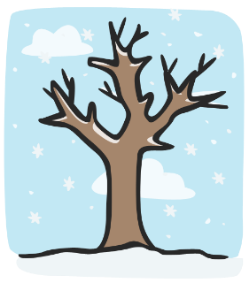
Questions
How are plants and animals adapted for seasonal change?
Some animals hibernate during the cold winter months.
Other animals will migrate to other countries to keep their body at the same temperature.

Slide 11
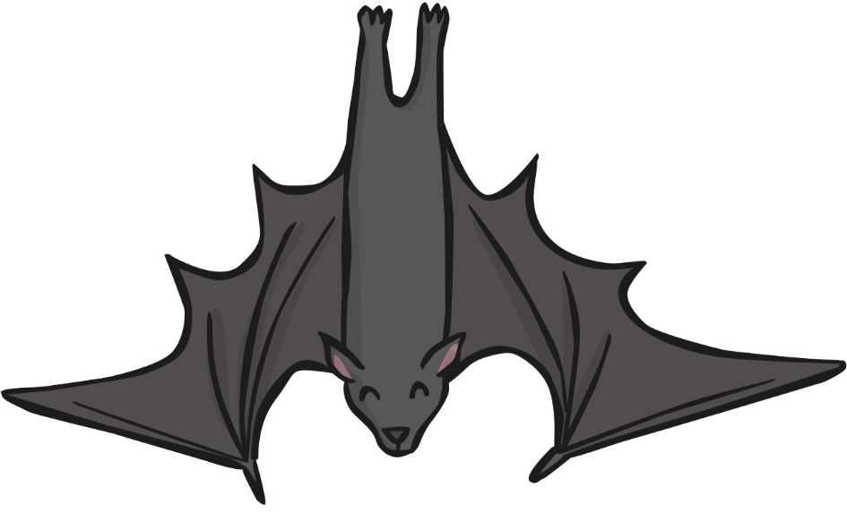
Hibernation
Hibernation occurs in some organisms, they slow down their body functions such as their breathing, heart rate and metabolism.
Animals store a great deal of energy during the summer months by eating plenty of food.
Animals that hibernate:
Bats
Hedgehogs
Tortoises

