Slide 2
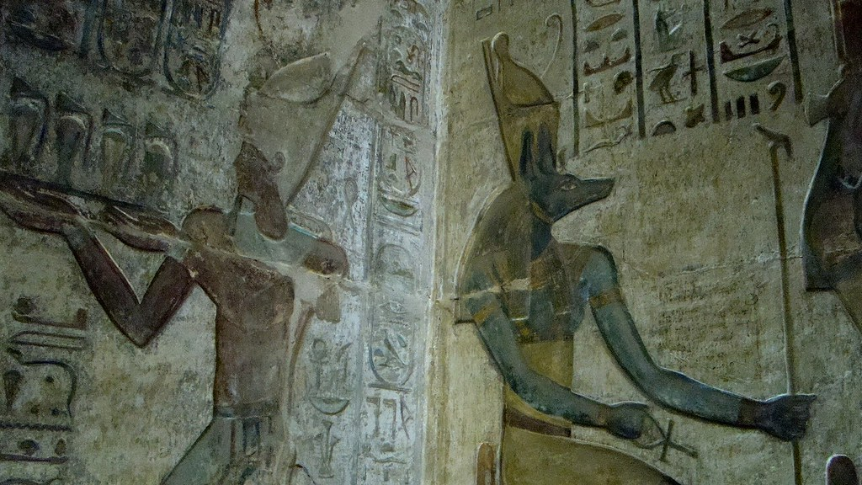
Crowns and Headdresses in Ancient Egypt
In ancient Egypt, crowns and headdresses were used:
to show that someone was powerful;
to make pictures of gods and rulers recognisable;
for religious ceremonies.
Ancient Egyptian pharaohs wore different crowns for different occasions and to show their loyalty to certain gods. Let’s take a look at some of the most famous ones.
Did You Know…?
No crown from a pharaoh has ever been found by archaeologists. It is likely that they were made from delicate materials such as fabric, leather or papyrus. Our best source of information is the paintings and carvings of gods and rulers that have survived.

Slide 3
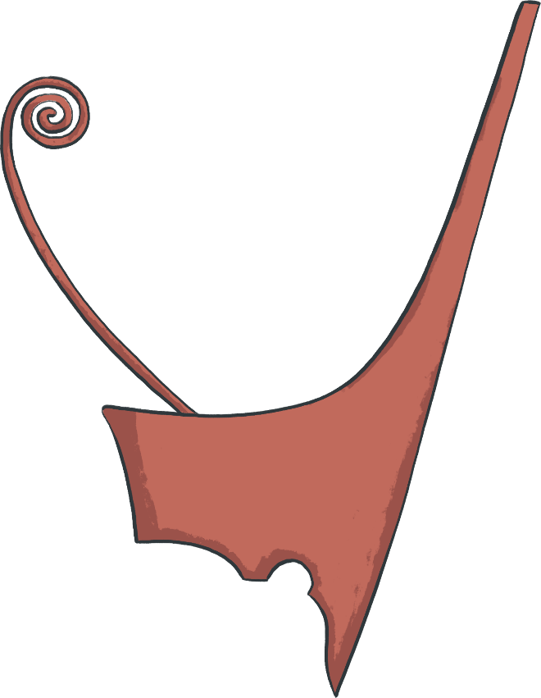
Deshret: The Red Crown
The Deshret was a high-backed crown which showed that the wearer was the ruler of Lower Egypt. It is thought that it was made from fabric or leather and had a copper or wire spiral.
The red crown was the symbol of the goddess Neith, who was the patron of the city of Sais in Lower Egypt.
Lower Egypt is the area around the Nile delta in the north of the country.

Slide 4
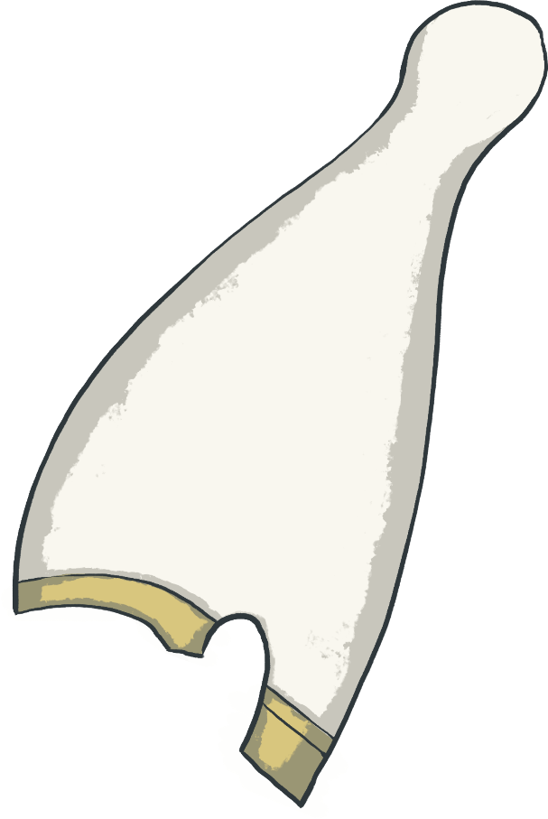
Hedjet: The White Crown
The white crown is also known as the Hedjet. It is tall with a rounded end and was probably made out of cloth or felt.
The white crown was worn by rulers of Upper Egypt (the south). It had a special association with the goddess Nekhbet, the white vulture goddess and protector of pharaohs.
Horus, the falcon god, was usually shown wearing the white crown.

Slide 5
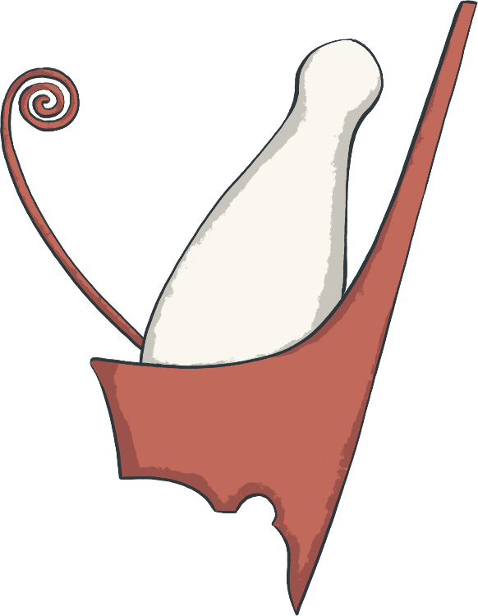
Pschent: The Double Crown
The double crown is also known as the Pschent crown or 'sekhemti', which means 'two powerful ones'.
Around 3100 BC, King Menes of Memphis brought together Lower and Upper Egypt and founded the First Egyptian Dynasty. A dynasty is a line of kings who all belonged to the same family. In total, 30 dynasties ruled over ancient Egypt.
Sometimes, you may see two animals attached to the front of this crown: a cobra, representing the goddess Wadjet of Lower Egypt, and a vulture, representing the goddess Nekhbet of Upper Egypt. Together, they were known as 'The Two Ladies'.
This crown is a combination of both the Deshret and Hedjet crowns, and kings wore the crown to show that they ruled over all Egypt.

Slide 6
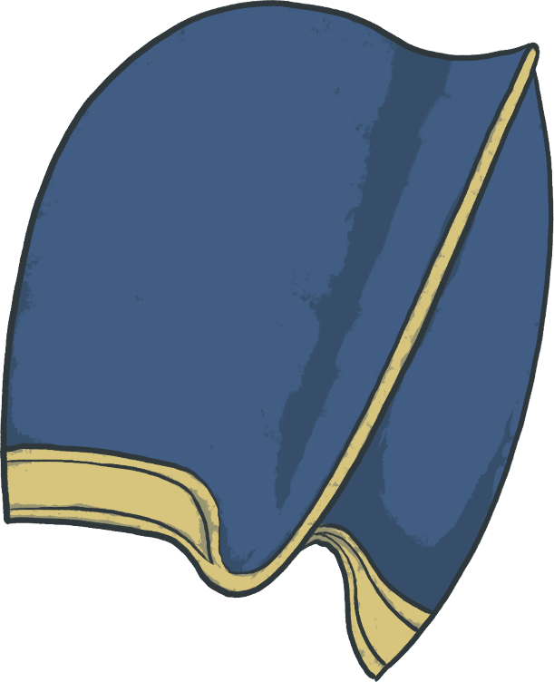
Kepresh: The Blue Crown
The blue crown was also known as the 'war crown' or the Kepresh Crown.
It was probably made from cloth or leather and then stained blue. Sometimes, it was decorated with gold, sun-shaped discs and a uraeus.
The Khepresh was often worn by pharaohs when going into war. We know this because many battle and hunting scenes show them wearing one.

Slide 7
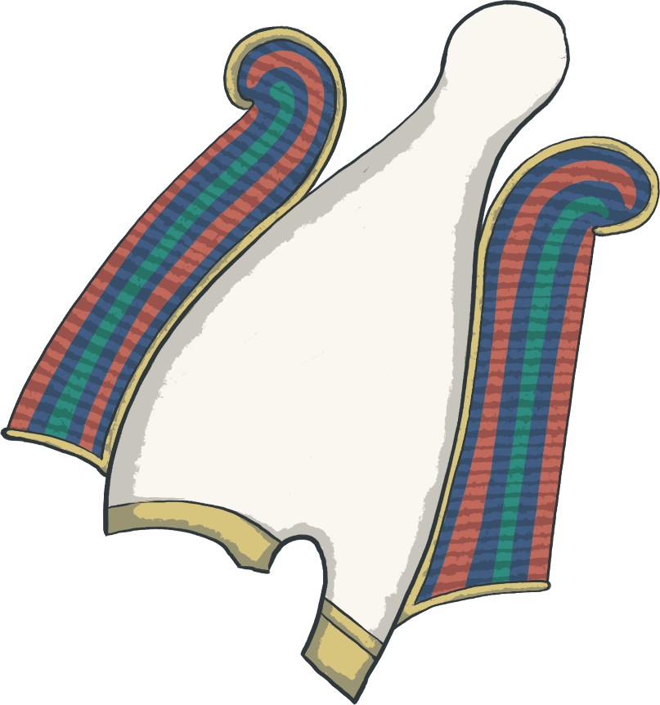
The Atef Crown
The Atef was worn during religious rituals. It was a white crown made from woven plant stems and trimmed with ostrich feathers. The later versions had a gold disk at the top to represent the sun.
The crown was most often worn by Osiris, the ruler of the Underworld. It looks a lot like the Hedjat crown but the two ostrich feathers are thought to represent truth and justice.

Slide 8
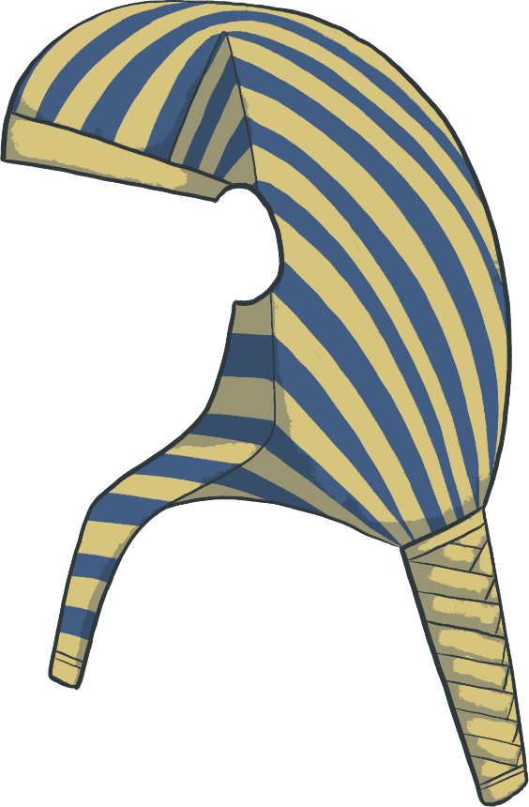
Nemes Headdress
The Nemes is not actually a crown, but a cloth worn by Egyptian rulers. Perhaps the most famous nemes headdress is shown on the death mask of Tutankhamun, the boy king.
The striped fabric covered the head of the pharaoh then draped down the back and over the shoulders. It was sometimes combined with the double crown and a uraeus.

Slide 9
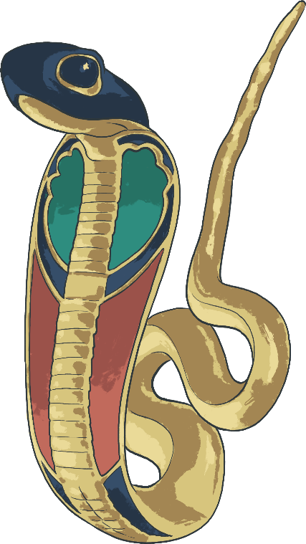
Ornaments
Sometimes, crowns had ornaments and symbols added to them. They may have been for protection or to symbolise a particular god.
The symbols were usually animals or plants. Sometimes, real feathers and horns were added to associate the wearer with a god who took the form of an animal, such as Amun.
Crowns of queens and princesses often used plant ornaments to symbolise beauty and youth.
The goddess Wadjet, protector of kings, is symbolised by a cobra. A uraeus is a small, upright cobra which was often added to the pharaoh’s crown to show his power and link to the gods.

Slide 10
Dress Like a Pharaoh
Which crown is your favourite? Can you create an image of yourself wearing an ancient Egyptian crown?

Slide 11
To find out more about ancient Egyptian life, read ‘Leila and the City of the Cat Goddess’ from Twinkl Originals.

